Slide 1
Set notation with Venn diagrams
1. Shade the diagrams to
match the descriptions
2. Describe the shaded areas
using set notation
Basic definitions
A
B
A
B
A
B
A
B
A
B
A’
Complement of A
Not A
A
B
A
B
A ∩ B’
A
B
A U B
Union, or
(at least 1)
A
B
A
B
A U B’
A
B
A ∩ B
Intersect, and
(both)
A
B
A
B
A U A’
Question
In a group of 100 students, 50 study Maths, 29 study Biology, and 13 study both.
Draw a Venn diagram and use it to find:
P(M) = P (M’) = P(B) = P(B’) =
P(M ∩ B) = P(M U B) = P(M ∩ B’) =
Extension: make up some more of your own.
M
B

Slide 2
Set notation with Venn diagrams – answers
1. Shade the diagrams to
match the descriptions
2. Describe the shaded areas
using set notation
Basic definitions
A
B
A
A
B
B
A
B
A
B
B’
A
B
A’
Complement of A
Not A
A
A
B
B
A
B
A’ ∩ B’
or (A U B)’
A ∩ B’
A
B
A U B
Union, or
(at least 1)
A
A
B
B
A
B
A’ U B’
or (A ∩ B)’
A U B’
A
B
A ∩ B
Intersect, and
(both)
A
A
B
B
A
B
A U A’
A’ U B
Question
In a group of 100 students, 50 study Maths, 29 study Biology, and 13 study both.
Draw a Venn diagram and use it to find:
P(M) = 50/100 = 0.5 P (M’) = 50/100 = 0.5 P(B) = 29/100 = 0.29 P(B’) = 71/100 = 0.71
P(M ∩ B) = 13/100 = 0.13 P(M U B) = 66/100 = 0.66 P(M ∩ B’) = 37/100 = 0.37
Extension: make up some more of your own.
M
B
37
13
16
34

Slide 3
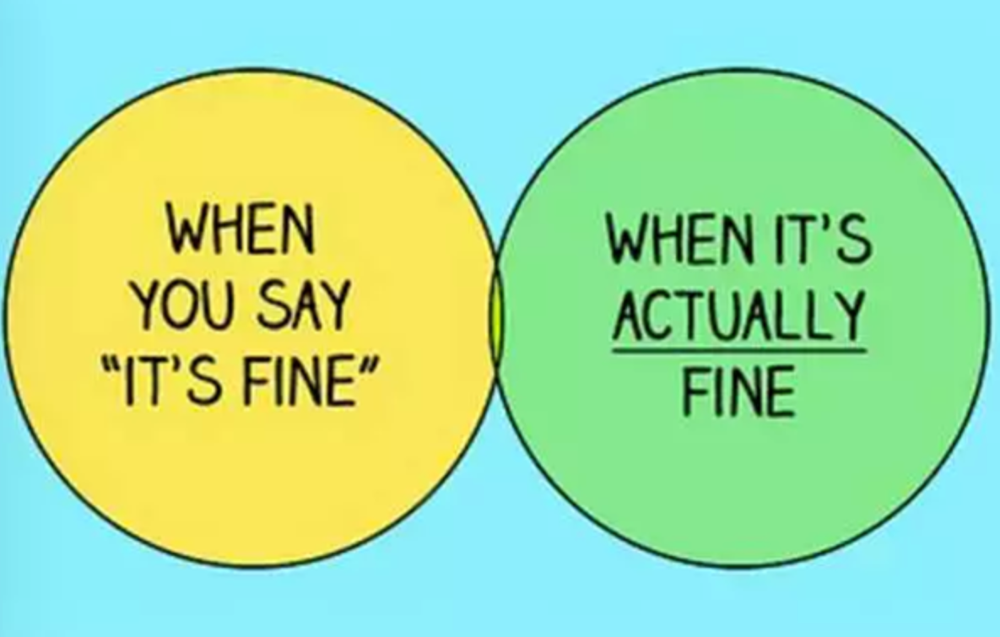
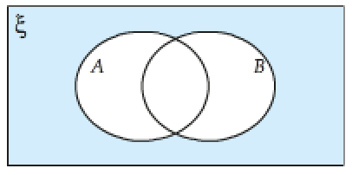







What have we learnt?
Which section represents A?
Which section represents B?
Which section represents A or B?
Which section represents A and B?
Which section represents A but not B?
Which section represents B but not A?
Which section represents neither A or B?

Slide 4
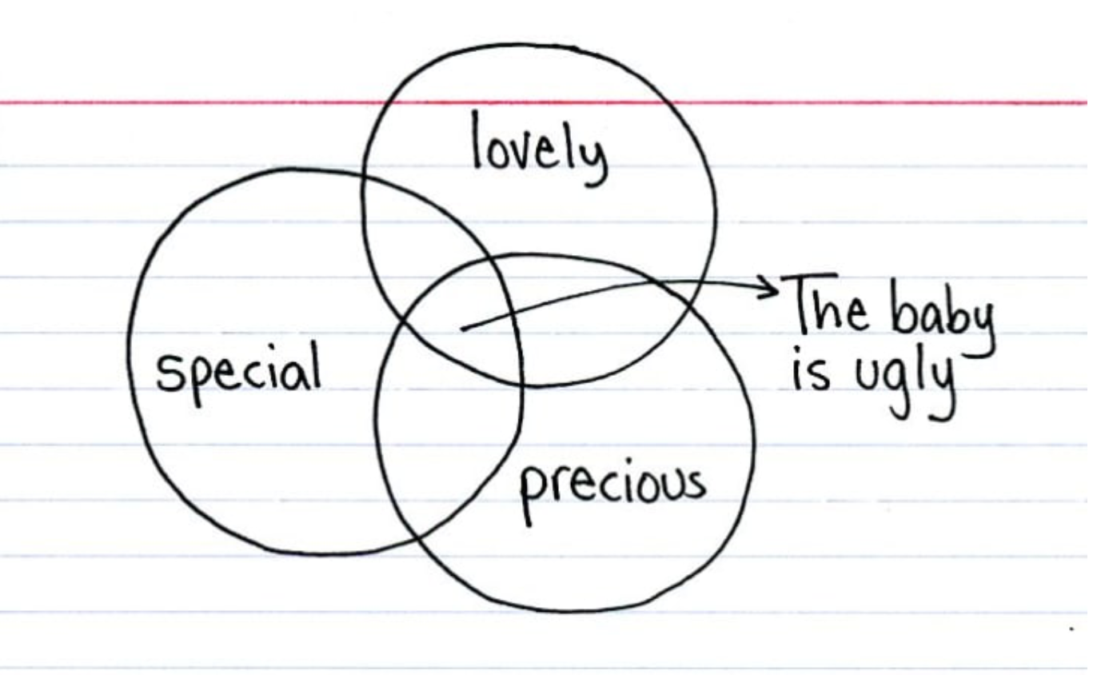
What have we learnt?

Slide 5
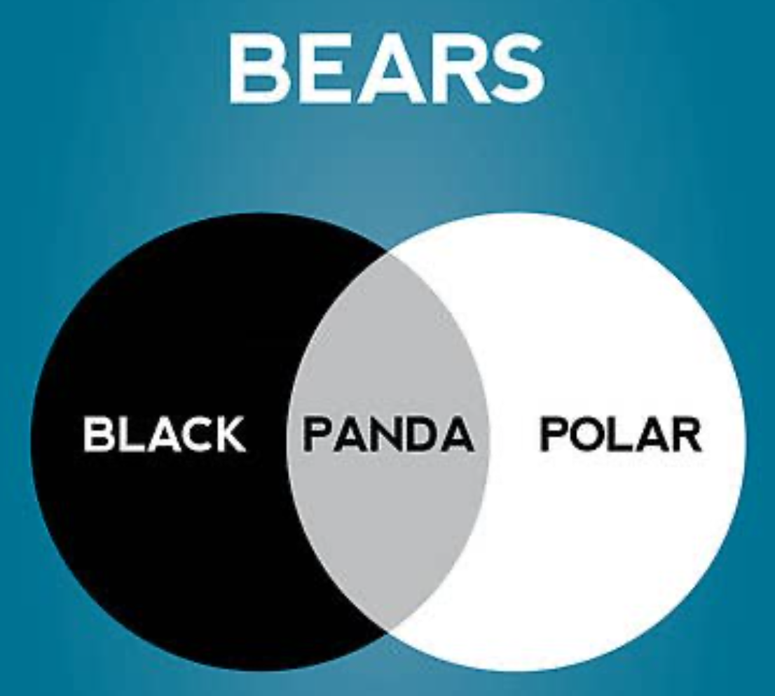
What have we learnt?

Slide 6
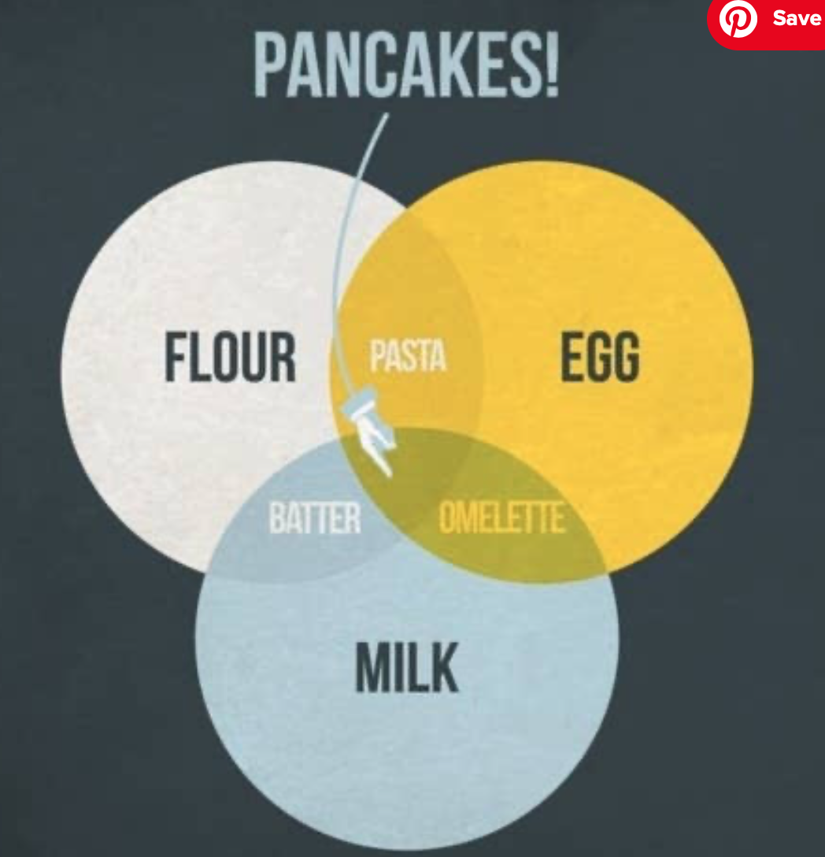
What have we learnt?

Slide 7
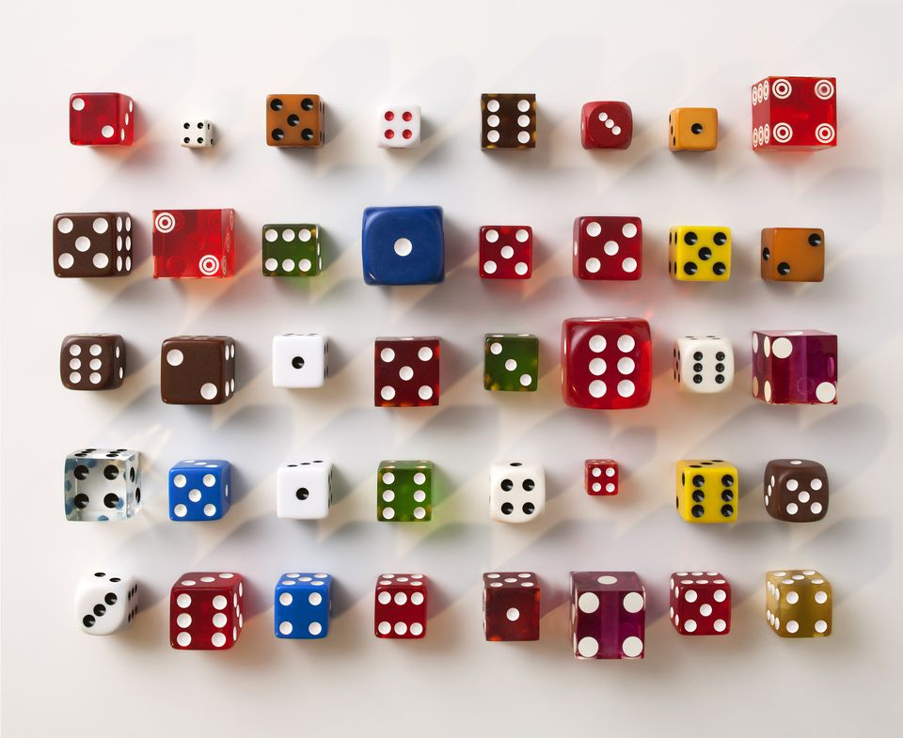
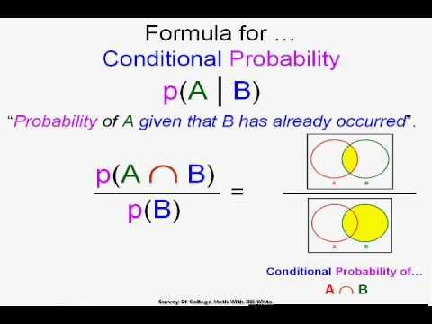

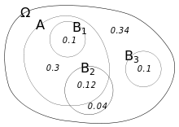
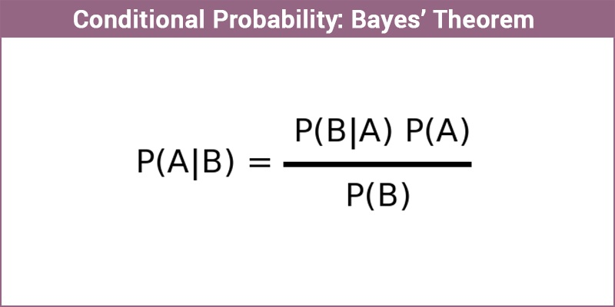
Conditional Probability

Slide 8

Conditional probability EQ: What is Conditional Probability and how does it differ from regular probability?
Conditional probability is the probability of an event occurring given that another event has already occurred.
P(A│B) means “the probability of A occurring, given that B has occurred”
For example, P(snow│summer) is much lower than P(snow│winter)
The second stage of a “without replacement” tree diagram is an example of conditional probability – the probabilities for the second stage vary depending on the outcome of the first stage
Venn diagrams and two-way tables are useful for calculating conditional probabilities.
The general formula for calculating conditional probability is
P (A│B) = $\frac{P(A and B)}{P(B)}$

Slide 9
Two-way tables
Fill in the blanks in this table showing ice-cream flavour preferences.
 | Choc | Strawb | Vanilla | Total
Male | 5 |  |  | 28
Female |  |  | 10
Total | 20 | 16 | 24 | 60
9
14
15
7
32
Can you see how addition law is applied here?
Now work out:
1. P(C) = 2. P(F) =
3. P(C∩F) = 4. P(CUF) =
5. P(C’) = 6. P(C’∩F) =
7. P(C’UF) = 8. P(C’UF’) =
20/60 = 1/3
32/60 = 8/15
15/60 = 1/4
(32+5)/60 = 37/60
(16+24)/60 = 2/3
(7+10)/60 = 17/60
(32+9+14)/60 = 11/12
1 - 15/60 = 3/4

Slide 10
Frequency trees
Convert the data in this 2-way table into a frequency tree.
 | Choc | Strawb | Vanilla | Total
Male | 5 | 9 | 14 | 28
Female | 15 | 7 | 10 | 32
Total | 20 | 16 | 24 | 60
C
5
Now use the frequency tree to work out:
P(C) =
P(C∩F) =
P(CUF) =
P(C’∩F) =
P(C’UF) =
28
9
S
M
V
14
Same answers
as before
60
C
15
F
32
7
S
V
10

Slide 11




Probability trees – with replacement
A bag contains 10 beads: 7 red and 3 yellow.
A bead is drawn out of the bag and replaced, then a second draw is made.
Use a probability tree to the determine the probability of drawing:
Two red beads
Two yellow beads
One red and one yellow
At least one red bead
2nd draw
(a) P(RR) = 49/100
(b) P(YY) = 9/100
(c) P(RY or YR) = 42/100
(d) P(RR or RY or YR)
= P (anything but YY)
= 1 – P(YY) = 91/100
R
1st draw
R
Y
R
Y
Y

Slide 12




Probability trees – without replacement
(Higher only)
A bag contains 10 beads: 7 red and 3 yellow.
Two beads are drawn out of the bag (without replacement).
Use a probability tree to the determine the probability of drawing:
Two red beads
Two yellow beads
One red and one yellow
At least one red bead
Relevant exercise:
p257 M8.11
Think carefully about the second draw!
2nd draw
(a) P(RR) = 7/15
(b) P(YY) = 1/15
(c) P(RY or YR)
= P(RY) + P(YR)
= 14/30 = 7/15
(d) P(RR or RY or YR)
= P (anything but YY)
= 1 – P(YY) = 14/15
R
1st draw
R
Y
R
Y
Y

Slide 13
Conditional probability (Higher only)
In a group of 100 students, 50 study Maths, 29 study Biology, and 13 study both.
Use the Venn diagram to find the probability that:
a student studies Biology, given that they study Maths
a student studies Maths, given that they don’t study Biology
a student studies both Maths and Biology, given that they study at least one of them.
Write your answers using set notation.
M
B
37
13
16
34
(a) Total number studying Maths = 50
Of these, the number studying Biology = 13
So P(B│M) = 13/50 or 0.26
(b) Total number NOT studying Biology = 34 + 37 = 71
Of these, the number studying Maths = 37
So P(M│B’) = 37/71 or 0.521 (3 s.f.)
(c) Total number studying Maths and/or Biology = 37 + 13 + 16 = 66
Of these, the number studying both subjects = 13
So P((M ∩ B) │(M U B)) = 13/66 or 0.197 (3 s.f.)
If the Venn diagram shows probabilities rather than frequencies, it still works in exactly the same way – just use the probabilities instead of the frequencies.
The value on the top should NEVER be bigger than the value on the bottom!
Now try p260 E8.2

Slide 14
Conditional probability using two-way tables
The table is already filled in for you this time.
 | Choc | Strawb | Vanilla | Total
Male | 5 | 9 | 14 | 28
Female | 15 | 7 | 10 | 32
Total | 20 | 16 | 24 | 60
Now try p262 q9
Now work out:
1. P(C) = 2. P(C│F) =
3. P(F) = 4. P(F│C) =
5. P(C│F’) = 6. P(F│C’) =
20/60 = 1/3
15/32
32/60 = 8/15
15/20 = 3/4
5/28
(7+10)/(16+24) = 17/40

Slide 15
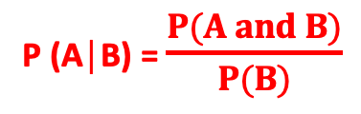
Independent events and multiplication law (Higher only)
If P(A│B) = P(A) then events A and B are said to be independent.
This means the probability of A occurring is the same regardless of whether or not B has occurred
Think of a tree diagram with replacement: the result of the first stage has no effect on the probabilities in the second stage
If this is the case then P(A∩B) = P(A) x P(B) (simplified “multiplication law”)
If P(A│B) is NOT equal to P(A) then the events are not independent.
This means that the probability of A depends on whether B has occurred
Think of a tree diagram without replacement: the probabilities in the second stage vary depending on the outcome of the first stage.
If the events are NOT independent then the multiplication law becomes P(A∩B) = P(A│B) x P(B)
This is just a rearrangement of the general formula on the conditional probability slide:
P (A│B) = $\frac{P(A and B)}{P(B)}$

Slide 16
Complete the Venn Diagram
In a class of 20, there are
11 boys
5 Pupils with glasses
3 boys that wear glasses
Where should you start?
At the place with most information
Then fill in gaps – be careful as there are already 3 in some groups!
B
G
7
8
3
2

Slide 17
Working with probability
When working with probability, we often use fractions
What is the probability of a randomly selected person from the class being a girl that does not wear glasses?
B
G
7
8
3
2
7 people satisfy the condition
7
Out of
20
20 – the total amount being considered in the question

Slide 18
Some quick questions
Find
P(B∩G)
P(BᴜG)
P(B’∩G)
3
B
G
7
20
13
20
8
3
2
2
20

Slide 19
The ‘given that’ statement
Sometimes a question may ask you to find the probability of an event, given that something has already happened.
This reduces the total amount being considered in the question (the denominator of the fraction)
It can also eliminate some of the amount that would normally satisfy the question (the numerator of the fraction).

Slide 20
The ‘given that’ statement
Question: Given that a boy is selected, what is the probability that they wear glasses?
We are now only considering boys – we can ignore all other values
B
G
7
8
3
2
3 people left still have glasses
3
Out of
11
The amount of boys – the ‘given that’ statement

Slide 21
Notation
We use the ‘|’ symbol to mean ‘given that’
P(G|B) means the probability that G happens, given that B has already happened (the previous question).
Note from the previous question that this was
B
G
7
8
3
2
Probability both happen
P(G∩B)
Out of
P(B)
The ‘given that’ statement

Slide 22
In General you can use the formula
P(A∩B)
= P(A|B)
P(B)
or
P(A∩B) = P(A|B) x P(B)

Slide 23
Similarly
P(A∩B)
= P(A|B)
P(B)
P(A’∩B)
P(A’|B) =
P(B)
P(A∩B’)
P(A|B’) =
P(B’)
And so on…

Slide 24
Let’s have a look at some more examples
In the following slides, the Venn diagrams or tree diagrams will all have been completed for you
In a test, however, this will normally be asked of you first.
You would then use your completed Venn diagrams or tree diagrams to calculate the probabilities
*Note you can always use the formulae to get to an answer quickly, but I like to visualise what is going on in each case – this is more important when dealing with tree diagrams

Slide 25
120 Pupils took a selection of subjects
48 took Geography
50 took History
23 took both History and Geography
H
G
45
Find
a) P(H)
b) P(G|H)
c) P(H’|(HUG))
50
27
23
25
120
23
50
25
75
*note that we could then simplify a) and c)

Slide 26
What if we are already given probabilities?
B
Follow the same approach
Find
P(B|A’)
P(C|A∩B)
P(B∩C’|AUC)
A
0.05
0.2
0.3
0.45
3
=
0.05
0.6
4
0.1
0.15
0.05
1
=
0.25
5
0.1
0.05
0.2
1
C
=
0.6
3

Slide 27

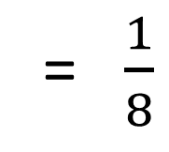





P(A) = $\frac{2}{5}$ P(B) = $\frac{1}{6}$ and P(B|A) = $\frac{1}{8}$ Find P(A’ ∩ B)
We need to start working out some probabilities. Using the given that statement, A has happened – let’s ignore everything else.
Let x be the intersection of A and B, then
P(B|A)
A
B
B
x = $\frac{2}{5}$ x $\frac{1}{8}$
x
$$\frac{1}{20}$$
$$\frac{7}{60}$$
x = $\frac{1}{20}$
x
So P(A’ ∩ B) = $\frac{1}{6} − \frac{1}{20}$
The only part of B left
‘what is the probability of B?’
= $\frac{1}{8}$
Out of
2/5
Remember that now the total probability is out of 2/5 -> P(A)
‘given that A has happened…’
= $\frac{7}{60}$
*Note that we could have found this straight away by using the formula
P(A∩B) = P(A|B) x P(B)

Slide 28
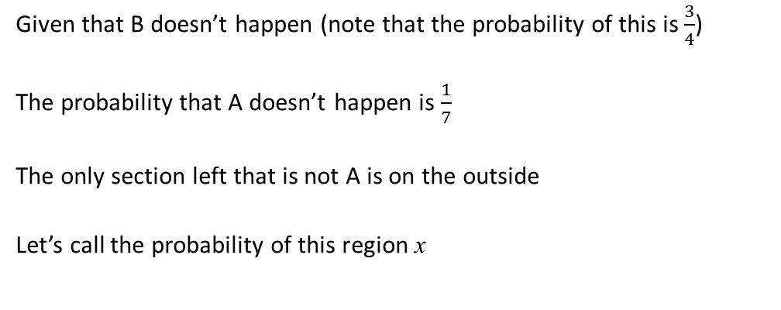
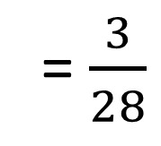
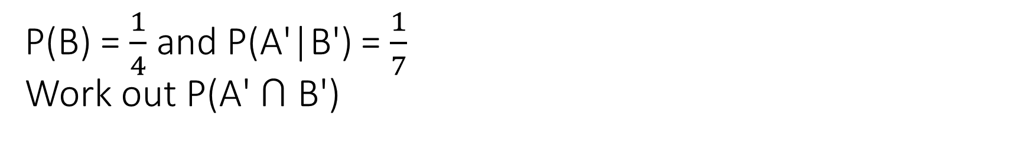

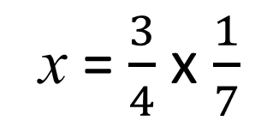
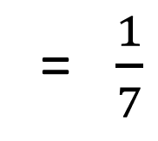
P(B) = $\frac{1}{4}$ and P(A'|B') = $\frac{1}{7}$ Work out P(A' ∩ B')
Given that B doesn’t happen (note that the probability of this is $\frac{3}{4}$)
The probability that A doesn’t happen is $\frac{1}{7}$
The only section left that is not A is on the outside
Let’s call the probability of this region x
A
B
x
= $\frac{1}{7}$
So
3/4
$$\frac{3}{28}$$
x
x = $\frac{3}{4}$ x $\frac{1}{7}$
= $\frac{3}{28}$
*Again we could use the formula, but sometimes it is easier to visualise what is going on. P(A’∩B’) = P(A’|B’) x P(B’)

Slide 29
While you can always use logic to visually decode questions like this, it is often easier to just use the formula (especially for more complex questions).
This is not always the case, however, for tree diagrams.

Slide 30
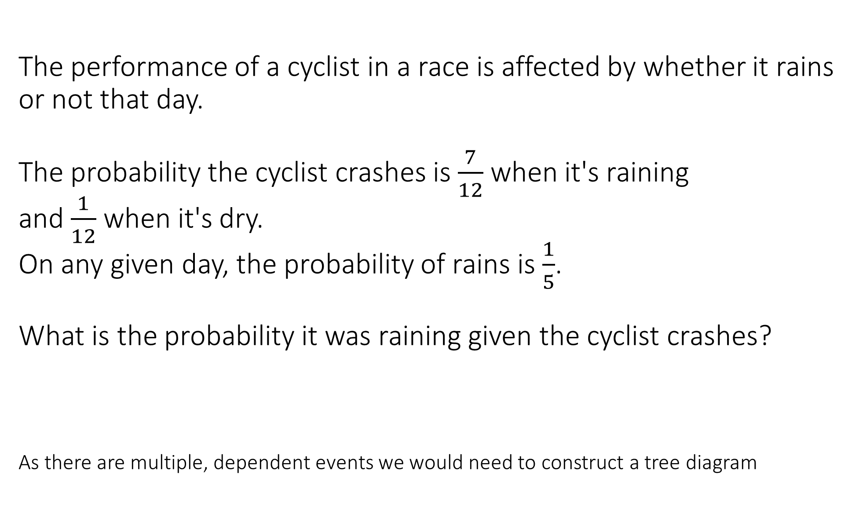
The performance of a cyclist in a race is affected by whether it rains or not that day. The probability the cyclist crashes is $\frac{7}{12}$ when it's raining and $\frac{1}{12}$ when it's dry. On any given day, the probability of rains is $\frac{1}{5}$. What is the probability it was raining given the cyclist crashes? As there are multiple, dependent events we would need to construct a tree diagram

Slide 31

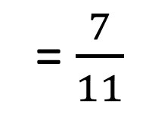

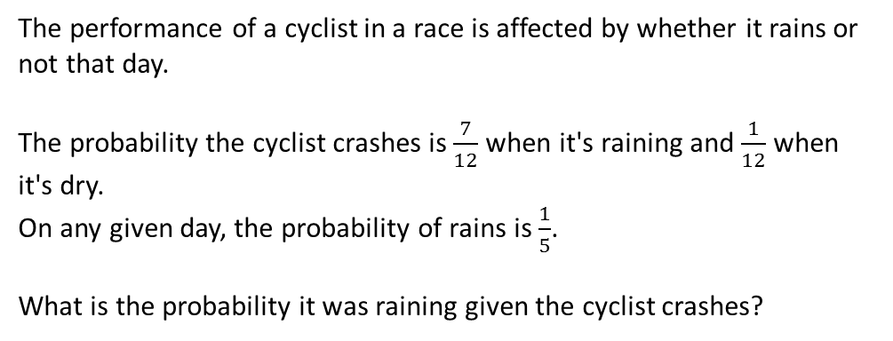




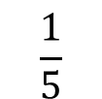



The performance of a cyclist in a race is affected by whether it rains or not that day. The probability the cyclist crashes is $\frac{7}{12}$ when it's raining and $\frac{1}{12}$ when it's dry. On any given day, the probability of rains is $\frac{1}{5}$. What is the probability it was raining given the cyclist crashes?
$$\frac{7}{60}$$
$$\frac{7}{12}$$
Crash
First calculate the probabilities of all outcomes – these are the only values we can use
$$\frac{1}{5}$$
Rains
$$\frac{5}{12}$$
$$\frac{5}{60}$$
Given that the cyclist crashes
No Crash
What is the probability it was raining?
$$\frac{1}{12}$$
$$\frac{4}{60}$$
Crash
$$\frac{4}{5}$$
7/60
Dry
= $\frac{7}{11}$
11/60
$$\frac{11}{12}$$
$$\frac{44}{60}$$
No Crash

Slide 32
Summary
When dealing with given that questions remember to only consider what has already happened.
Fractions are often the best and most accurate way of leaving an answer
Make sure your knowledge of Venn diagrams is spot on so you know which regions the question refers to
Find an approach that works best for you – if that is to simply use the formula then just use the formula (but make sure you check your answers to see if they make sense)

